Slide 1
ARE 395R/CE 395R 5- Data Mining Mining Association Rules (Part II)

Slide 2
Effect of Support Distribution
How to set the appropriate minsup threshold?
If minsup is set too high, we could miss itemsets involving interesting rare items (e.g., expensive products)
If minsup is set too low, it is computationally expensive and the number of itemsets is very large
Using a single minimum support threshold may not be effective

Slide 3
Pattern Evaluation
Association rule algorithms tend to produce too many rules
many of them are uninteresting or redundant
Redundant if {A,B,C} → {D} and {A,B} → {D} have same support & confidence
Interestingness measures can be used to prune/rank the derived patterns
In the original formulation of association rules, support & confidence are the only measures used

Slide 4
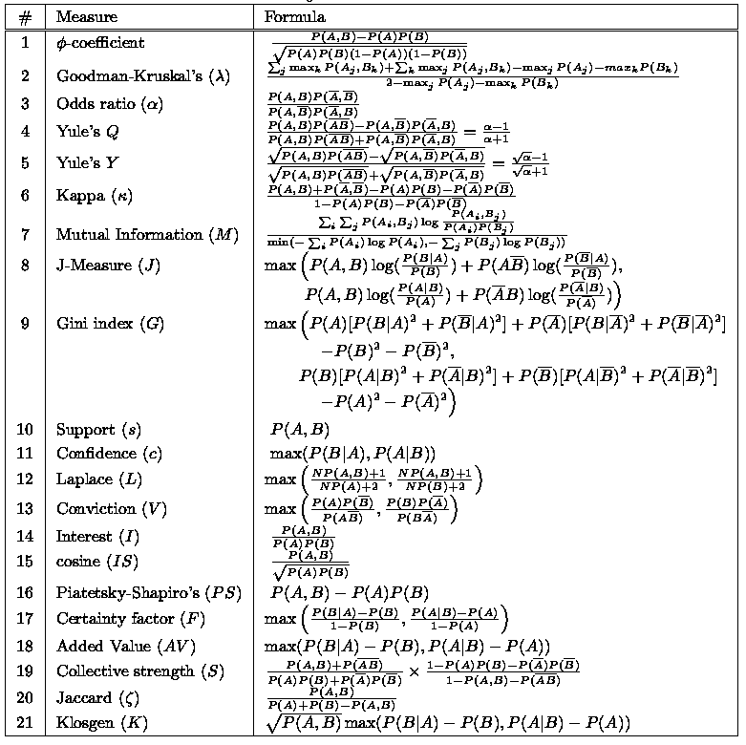
There are lots of measures proposed in the literature
Some measures are good for certain applications, but not for others

Slide 5
Continuous and Categorical Attributes
How to apply association analysis formulation to non-asymmetric binary variables?
Example of Association Rule:
{Number of Pages ∈[5,10) ∧ (Browser=Mozilla)} → {Buy = No}

Slide 6
Handling Categorical Attributes
Transform categorical attribute into asymmetric binary variables
Introduce a new “item” for each distinct attribute-value pair
Example: replace Browser Type attribute with
Browser Type = Internet Explorer
Browser Type = Mozilla
Browser Type = Netscape

Slide 7
Handling Categorical Attributes
Potential Issues
What if attribute has many possible values
Example: attribute country has more than 200 possible values
Many of the attribute values may have very low support
Potential solution: Aggregate the low-support attribute values
What if distribution of attribute values is highly skewed
Example: 95% of the visitors have Buy = No
Most of the items will be associated with (Buy=No) item
Potential solution: drop the highly frequent items

Slide 8
Handling Continuous Attributes
Different kinds of rules:
Age∈[21,35) ∧ Salary∈[70k,120k) → Buy
Salary∈[70k,120k) ∧ Buy → Age: μ=28, σ=4
Different methods:
Discretization-based
Non-discretization based

Slide 9
Discretization Issues
Size of the discretized intervals affect support & confidence
If intervals too small
may not have enough support
If intervals too large
may not have enough confidence
Potential solution: use all possible intervals
{Refund = No, (Income = $51,250)} → {Cheat = No}
{Refund = No, (60K ≤ Income ≤ 80K)} → {Cheat = No}
{Refund = No, (0K ≤ Income ≤ 1B)} → {Cheat = No}

Slide 10
Handling a Concept Hierarchy

Slide 11
Multi-level Association Rules
Issues with concept hierarchy:
Rules at lower levels may not have enough support to appear in any frequent itemsets
Rules at lower levels of the hierarchy are overly specific
e.g., skim milk → white bread, 2% milk → wheat bread, skim milk → wheat bread, etc. are indicative of association between milk and bread

Slide 12
Sequence Data
Sequence Database:
Object
Timestamp
Events
A
10
2, 3, 5
A
20
6, 1
A
23
1
B
11
4, 5, 6
B
17
2
B
21
7, 8, 1, 2
B
28
1, 6
C
14
1, 8, 7

Slide 13
Examples of Sequence Data
Sequence Database | Sequence | Element (Transaction) | Event (Item)
Customer | Purchase history of a given customer | A set of items bought by a customer at time t | Books, diary products, CDs, etc
Web Data | Browsing activity of a particular Web visitor | A collection of files viewed by a Web visitor after a single mouse click | Home page, index page, contact info, etc
Event data | History of events generated by a given sensor | Events triggered by a sensor at time t | Types of alarms generated by sensors
Genome sequences | DNA sequence of a particular species | An element of the DNA sequence | Bases A,T,G,C
Element (Transaction)
Event (Item)
E1 E2
E1 E3
E2
E2
E3 E4
Sequence

Slide 14
Formal Definition of a Sequence
A sequence is an ordered list of elements (transactions)
s = < e₁ e₂ e₃ … >
Each element contains a collection of events (items)
e_{i} = {i₁, i₂, …, i_{k}}
Each element is attributed to a specific time or location
Length of a sequence, |s|, is given by the number of elements of the sequence
A k-sequence is a sequence that contains k events (items)

Slide 15
Examples of Sequence
Web sequence:
< {Homepage} {Electronics} {Digital Cameras} {Canon Digital Camera} {Shopping Cart} {Order Confirmation} {Return to Shopping} >
Sequence of initiating events causing the nuclear accident at 3-mile Island: (http://stellar-one.com/nuclear/staff_reports/summary_SOE_the_initiating_event.htm)
< {clogged resin} {outlet valve closure} {loss of feedwater} {condenser polisher outlet valve shut} {booster pumps trip} {main waterpump trips} {main turbine trips} {reactor pressure increases}>
Sequence of books checked out at a library:
<{Fellowship of the Ring} {The Two Towers} {Return of the King}>

Slide 16
Formal Definition of a Subsequence
A sequence <a₁ a₂ … a_{n}> is contained in another sequence <b₁ b₂ … b_{m}> (m ≥ n) if there exist integers i₁ < i₂ < … < i_{n} such that a₁ ⊆ b_{i1} , a₂ ⊆ b_{i1}, …, a_{n} ⊆ b_{in}
The support of a subsequence w is defined as the fraction of data sequences that contain w
A sequential pattern is a frequent subsequence (i.e., a subsequence whose support is ≥ minsup)
Data sequence | Subsequence | Contain?
< {2,4} {3,5,6} {8} > | < {2} {3,5} > | Yes
< {1,2} {3,4} > | < {1} {2} > | No
< {2,4} {2,4} {2,5} > | < {2} {4} > | Yes

Slide 17
Sequential Pattern Mining: Definition
Given:
a database of sequences
a user-specified minimum support threshold, minsup
Task:
Find all subsequences with support ≥ minsup

Slide 18
Sequential Pattern Mining: Example
Minsup = 50%
Examples of Frequent Subsequences:
< {1,2} > s=60%
< {2,3} > s=60%
< {2,4}> s=80%
< {3} {5}> s=80%
< {1} {2} > s=80%
< {2} {2} > s=60%
< {1} {2,3} > s=60%
< {2} {2,3} > s=60%
< {1,2} {2,3} > s=60%

Slide 19
Timing Constraints (I)
{A B} {C} {D E}
x_{g}: max-gap
n_{g}: min-gap
m_{s}: maximum span
<= x_{g}
>n_{g}
<= m_{s}
x_{g} = 2, n_{g} = 0, m_{s}= 4
Data sequence | Subsequence | Contain?
< {2,4} {3,5,6} {4,7} {4,5} {8} > | < {6} {5} > | Yes
< {1} {2} {3} {4} {5}> | < {1} {4} > | No
< {1} {2,3} {3,4} {4,5}> | < {2} {3} {5} > | Yes
< {1,2} {3} {2,3} {3,4} {2,4} {4,5}> | < {1,2} {5} > | No

Slide 20
Mining Sequential Patterns with Timing Constraints
Approach 1:
Mine sequential patterns without timing constraints
Postprocess the discovered patterns
Approach 2:
Modify algorithms to directly prune candidates that violate timing constraints

